Slide 1
CSCI U511 01 Operating Systems AKM Jahangir A Majumder, PhD
Fall 2019 - Lecture 3
August 29, 2019
Note: Some slides are adapted from those used by previous instructors and some slides include figures from the textbook.

Slide 2
Review and Learning Outcomes
We discussed basic concept of OS and OS system evaluation
We will discuss Processes and Abstraction today
Processes
Threads
Kernels Abstraction
Please read the syllabus
We will have our first quiz on Thursday, September 5 which will cover lectures 1-3
HW 1 will post on Blackboard soon which is due on Tuesday, Sept. 3
We will discuss your project proposal today

Slide 3
Chap. 2: The Kernel Abstraction

Slide 4
Debugging as Science
Understanding -> design -> code
not the opposite
Form a hypothesis that explains the bug
Which tests work, which don’t. Why?
Add tests to narrow possible outcomes
Use best practices
Always walk through your code line by line
Module tests – narrow scope of where problem is
Develop code in stages, with dummy replacements for later functionality
Notes:
Form a hypothesis. You have inputs – what you typed. Outputs – what the program did. What possible hypotheses explain the problem? Can you develop a test to differentiate between those possibilities?
Its also helpful to step through your code, one instruction at a time. You wrote the control flow, does it follow your intent?
Module tests – develop ways of testing sub-sets, so that you can eliminate them from the possible hypotheses that would explain the program behavior.
Stubs – develop code in stages, with dummy replacements for certain

Slide 5
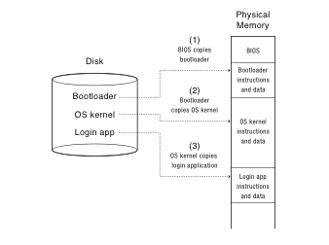
Booting
Notes:
When you power up a computer, what happens? Starts executing instructions. Why not start running the OS in step 1?
Why does the BIOS load the bootloader?
When the OS starts running, are interrupts enabled?
When will it be possible to start displaying things to the screen? Or console.
OS/161 – you start running the OS kernel after the bootloader has loaded it.
Why not just start running the app in the kernel?
Kind of inconvenient if you have to reboot all the time, just to change the app!
Also, could allow the app to access data on disk that it doesn’t have permission to do, etc.

Slide 6
Device Interrupts
OS kernel needs to communicate with physical devices
Devices operate asynchronously from the CPU
Polling: Kernel waits until I/O is done
Interrupts: Kernel can do other work in the meantime
Device access to memory
Programmed I/O: CPU reads and writes to device
Direct memory access (DMA) by device
Buffer descriptor: sequence of DMA’s
E.g., packet header and packet body
Queue of buffer descriptors
Buffer descriptor itself is DMA’ed
Notes:
OK, a quick tour of I/O. Without I/O, can’t do much of anything!

Slide 7
Challenge: Protection
How do we execute code with restricted privileges?
Either because the code is buggy or if it might be malicious
Some examples:
A script running in a web browser
A program you just downloaded off the Internet
A program you just wrote that you haven’t tested yet
Notes:
Not just about OS’es; not just bugs

Slide 8
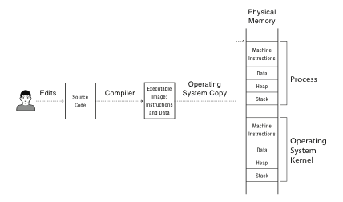
A Problem
A user edits, compiles and run a user program. Other programs can also be stored in physical memory, including the operating systems itself.
Notes:
OK, so you compile your program into an executable image with instructions and data.
Which of these is the program? How does it start running? Well, if its Javascript – no compilation step! Just interprets the source code.
If its Android, then its compiled into a byte code that is interpreted in software – well, actually, interpreted into short snippets of instructions, with jumps back into the interpreter when done.
If it’s attu, then compiled into x86 instructions.
What’s to keep the process from overwriting the OS kernel? Or some other process running at the same time?
What’s to keep it from overwriting the disk? From reading someone else’s files that are stored on disk?

Slide 9
Main Points
Process concept
A process is the OS abstraction for executing a program with limited privileges
Dual-mode operation: user vs. kernel
Kernel-mode: execute with complete privileges
User-mode: execute with fewer privileges
Safe control transfer
How do we switch from one mode to the other?

Slide 10
Process Abstraction
Process: an instance of a program, running with limited rights
Thread: a sequence of instructions within a process
Potentially many threads per process (for now 1:1)
Address space: set of rights of a process
Memory that the process can access
Other permissions the process has (e.g., which system calls it can make, what files it can access)

Slide 11
Thought Experiment
How can we implement execution with limited privilege?
Execute each program instruction in a simulator
If the instruction is permitted, do the instruction
Otherwise, stop the process
How do we go faster?
Run the unprivileged code directly on the CPU!
Notes:
Upsides? Downsides to this approach? Essentially what you do in Javascript in a browser – simulate the execution of the script, one line at a time.

Slide 12
Hardware Support: Dual-Mode Operation
Kernel mode
Execution with the full privileges of the hardware
Read/write to any memory, access any I/O device, read/write any disk sector, send/read any packet
User mode
Limited privileges
Only those granted by the operating system kernel
On the x86, mode stored in EFLAGS register
On the MIPS, mode in the status register
Notes:
Obviously, you need the part that has full rights to be really reliable!

Slide 13
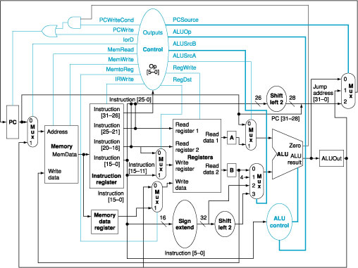
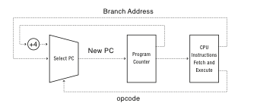
A Model of a CPU
The basic operation of a CPU, Opcode, is the decoded instruction to be executed

Slide 14
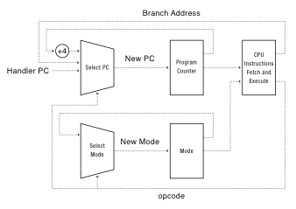
A CPU with Dual-Mode Operation
The Operation of a CPU with kernel and user modes
Notes:
Where do interrupts fit in?

